Slide 1

Smoke Detection and Fire Prevention with Arduino and MQ2 Sensor
EMBEDDED PROGRAMMING PROJECT
SUBJECT CODE:- IT2304
Team name:- quarks

Slide 2


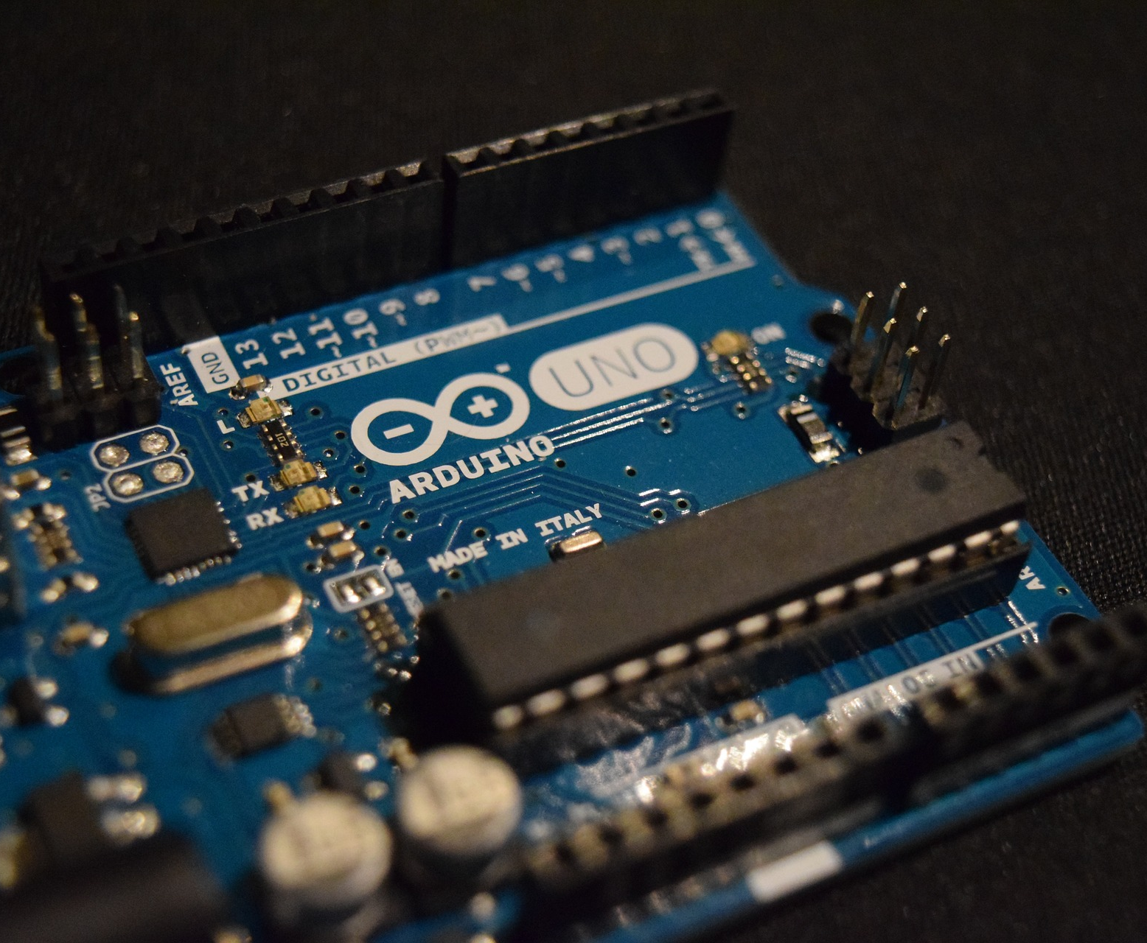
Components
MQ-2 Sensor
1. Resistor (1kΩ)
LED
Arduino UNO
Jumping Wires
Battery (5 V)
Bread Board

Slide 3
ABSTRACT
The Smoke Identification Device is a revolutionary innovation in fire safety technology, offering a robust and cost-effective solution for early smoke detection. This project harnesses the power of an Arduino UNO microcontroller and an MQ2 Gas Sensor to provide a swift response to potential fire hazards by detecting the presence of smoke particles in the air.
In a world where fire incidents pose significant risks to lives and properties, the significance of early detection cannot be overstated. This project report delves into the intricacies of the Smoke Identification Device, unveiling its components, operational principles, and code implementation.
It explores the device's circuit design, meticulously analyzing the role of each component and its contribution to system stability and reliability. The code implementation is dissected, offering a detailed understanding of the logic behind smoke detection and LED signaling.
Extensive testing and data analysis substantiate the device's efficiency and accuracy, while discussions on challenges and limitations provide valuable insights for future enhancements. Moreover, the report examines the project's relevance in the context of existing smoke detection technologies and envisions its potential for broader applications in fire prevention and safety systems.
The Smoke Identification Device presents a remarkable blend of simplicity and effectiveness, and this project report serves as a comprehensive guide for replication, further development, and utilization of this innovative fire safety solution.

Slide 4
Brief introduction of the project
There are two types of smoke detectors. Optical or Photoelectric smoke detectors and Ionization smoke detectors. Optical smoke detectors consists of a light source like LED and a light detector like photocell.
The photocell conducts as long as the light falls on it. When there is smoke, the light from the source is interrupted and the photocell doesn’t conduct.
Ionization smoke detectors consists of two electrodes and an ionization chamber filled with ions. When there is no smoke, the ions move freely and the electrodes conduct normally.
In the presence of smoke, the chamber is filled with smoke and interrupts the movement of ions. The electrodes do not conduct anymore. Depending on the type of sensor and manufacturer, the conductivity conditions may change but the idea remains the same.
Based on the output of the smoke detector, an alarm system can be implemented.
The sensor used in this project is MQ-2 Gas/Smoke sensor. It is sensitive to LPG, Hydrogen, Smoke, Methane, Propane, Alcohol, Butane and other industrial combustible gases.
It has two electrodes made of Aluminum Oxide (Al2O3) and a heating element made of Tin dioxide (SnO¬2) which acts as the main sensing layer.

Slide 5
code
const int sensorPin = A0;
const int ledRed = 13;
const int ledGreen = 12;
void setup() {
Serial.begin(9600);
pinMode(ledGreen, OUTPUT);
pinMode(ledRed, OUTPUT);
}
void loop() {
int sensorValue = analogRead(sensorPin);
Serial.println(sensorValue);
if (sensorValue > 600) {
digitalWrite(ledRed, HIGH);
digitalWrite(ledGreen, LOW);
}
else {
digitalWrite(ledGreen, HIGH);
digitalWrite(ledRed, LOW);
}
delay(1000);}

Slide 6

Circuit diagram

Slide 7
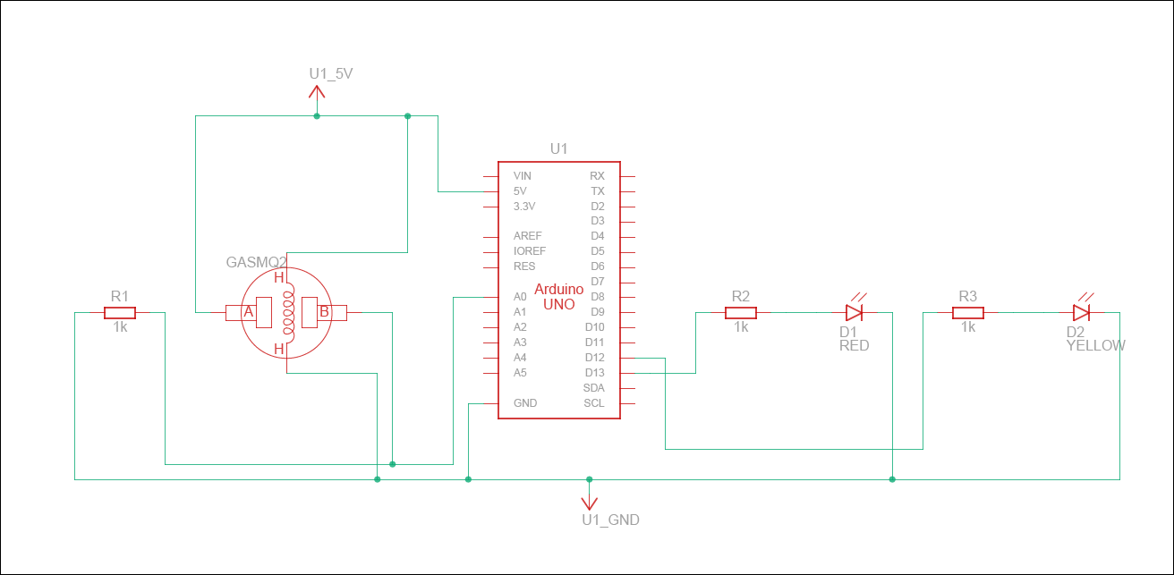
Circuit diagram

Slide 8
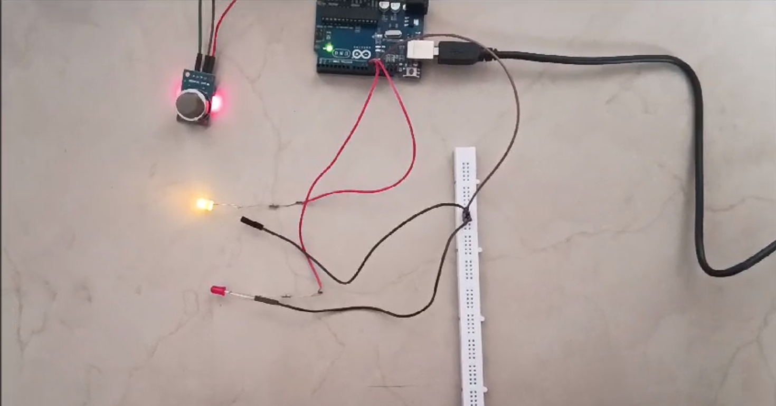
working
When Smoke not Detected: When the Smoke doesn’t come in contact with the MQ2 Gas Sensor, the ppm value of the gas is not sensed by the sensor, so yellow Led used in the circuit starts to blink indicating that the situation is out of danger
When Smoke Detected: When the Smoke comes in contact with the MQ2 Gas Sensor, the ppm value of the gas issensed by the sensor (which is displayed in the Serial Monitor) then the Arduino microcontroller converts the analog value into digital value which is being interpreted by the code and then Red Led used in the circuit starts to blink indicating the presence of gas and the situation is in danger

Slide 9


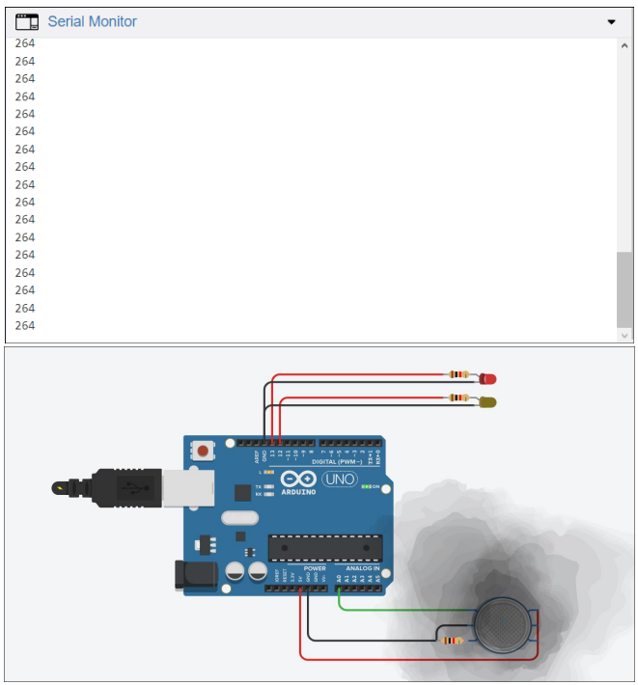

Slide 10
working
Initially, when the air is clean, the conductivity between the electrodes is less, as the resistance is in the order of 50KΩ. The inverting terminal input of comparator is higher than the non-inverting terminal input. The indicator LED is OFF.
In the event of fire, when the sensor is filled with smoke, the resistance of the sensor falls to 1KΩ and the conductivity between the electrodes increases.
This provides a higher input at the non-inverting terminal of comparator than the inverting terminal and the output of comparator is high. The alarming LED is turned ON as an indication of presence of smoke.
Note
The heating element in the Smoke Sensor must be preheated before it can sense any smoke or gas.
The sensor gets hot because of the heating coil and it is advised not to touch the sensor while it is switched on.
The sensitivity of the circuit to different concentrations of smoke can be adjusted by using the POT.
The output LED can be replaced with a loud buzzer for effective alarm.

Slide 11


Slide 12
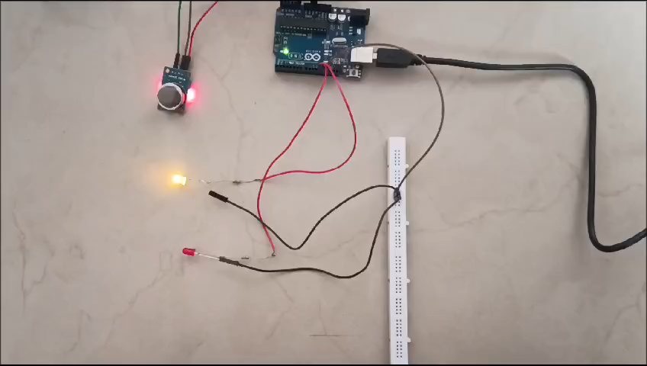

Slide 13

Thank You!
Team Members
Adhithya s
Arun Pranav a t
Dhejan r
Jawagal Srinath

